Slide 1


Cover 1
LinkBot
2019.06.15 – Team name : WebsiteAnalysts
Kevin Nguyen 50181575 | Oulladji Nabil 50187566
Notes:
Change the image:
1- Right click on the transparent shape >> Send to Back >> Send to Back
2- Right Click on Image >> Change Picture >> Choose your Image
3- Right Click on Image >> Send to Back >> Send to Back

Slide 2

Agenda
Team work
1 – Project introduction
2 - Roadmap
3 - Module descriptions
4 - Detail description
5- Module descriptions
Confidential - 2
Notes:
Change the image:
1- Right click on the transparent shape >> Send to Back >> Send to Back
2- Right Click on Image >> Change Picture >> Choose your Image
3- Right Click on Image >> Send to Back >> Send to Back

Slide 3
LinkBot introduction
Slide 8
Project Overview
LinkBot is a website dedicated to analyze a website through its HTML Code in order to determinate the purpose and help the user to understand the main topic(s) using Text Ranking. It based on a chatbot conversation.

Slide 4

Project Roadmap
Project Planning Activities
May
2nd week
3rd week
4th week
June
1st week
Today
22 jours
Conception and analysis of the project (4 days)
15 jours
Database (3 days/ Back-end)
8 jours
15 jours
Datamodel (4 days / All)
22 jours
Generic Views (10 days / Front-end)
8 jours
API (10 days / Back-end)
15 jours
15 jours
Project Management (X days/ All)
Test, Deployment, Debug (4 days / All)
22 jours
29 jours
15 jours
64 jours
8 jours

Slide 5
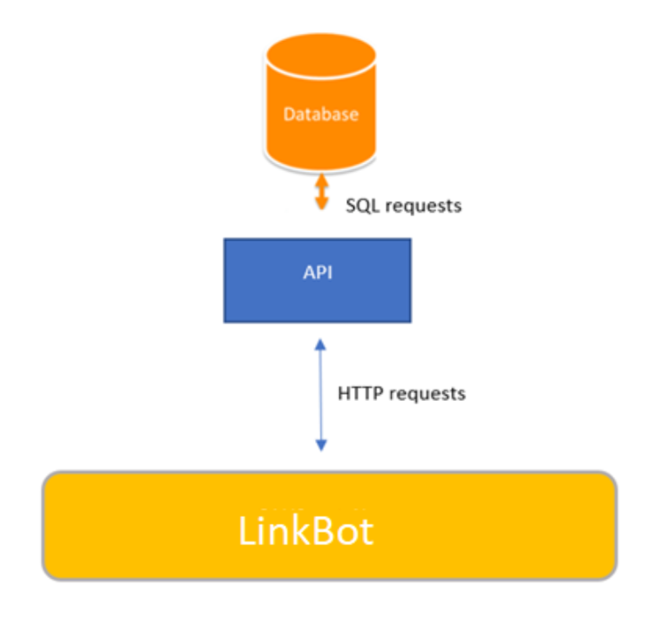
Modules description
Slide 8
Project Overview

Slide 6
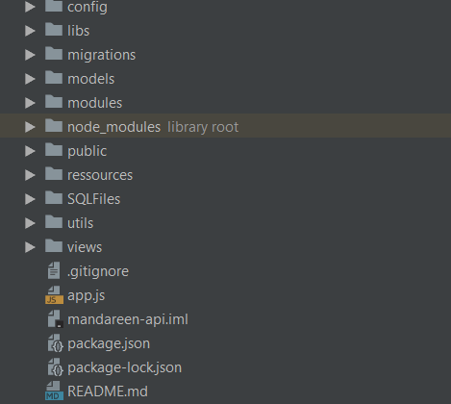

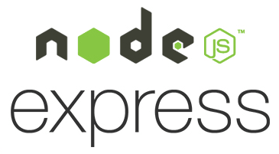

Details description : The API-Rest with Express
Slide 8
Project Overview
As we plan to use Angular6 (Front-end framework) with a JavaScript back-end for the website and Node.JS (express module) for our API.
Our API will be linked with our database where we will store the articles with their title, introduction, content. We will use MYSQL to communicate with this one. phpMyAdmin is a free software tool written in PHP, intended to handle the administration of MySQL over the Web. phpMyAdmin supports a wide range of operations on MySQL and MariaDB with HTTP requests: GET, PUT, POST, DELETE etc.
API architecture:
/config: This folder is used to put all our configuration variables like the host port, mySQL configuration etc.
/libs: We put all our homemade libraries as the error or mail library.
/models: as we use Sequelize, we must define again all our models/table from our database.
/node_modules: this folder content all the dependencies/module managed by NodeJS.
/modules: this folder content all the controller files and routes that developers can request.
Package.json: a JSON file where all dependencies are listed.
API structure built by Express module.

Slide 7


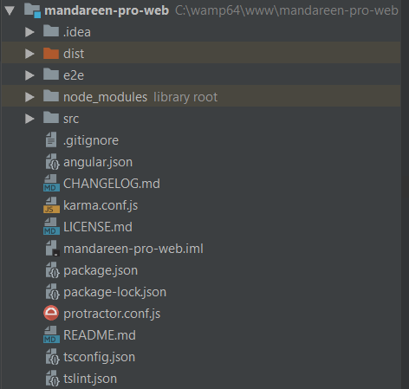
Details description : The Website with Angular
Slide 8
Project Overview
The Angular project is using an MVC architecture, the component is composed of Typescript (.ts), HTML, CSS and/or SCSS files.
/src : in this folder, you can find all the source files called component. In Angular, there is the module files which are used to declare the components. A component contains the back-end source code. There is also the route file which allow users to access to the different urls.
/node_modules: this folder content all the dependencies/module managed by NodeJS.
package.json: a JSON file where all dependencies are listed.

Slide 8
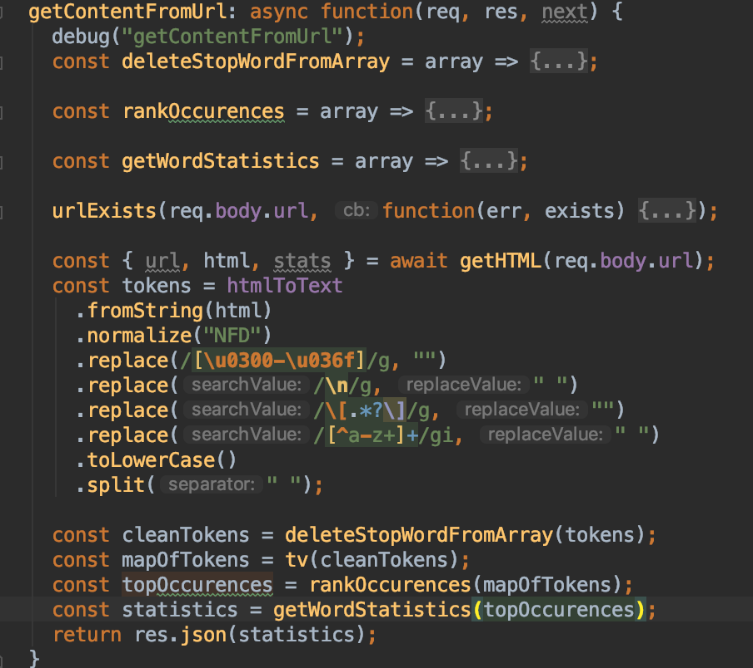
How to analyze from a HTML ?
Slide 8
Project Overview
HTML
Tokens
Text
Tokens indexing
Cleaned text
Tokens ranking
Encoding to UTF-8
Deleting non-alphabetic characters
Deleting stop words
Ranking the tokens by occurrences
Determinate their frequency (%)

Slide 9
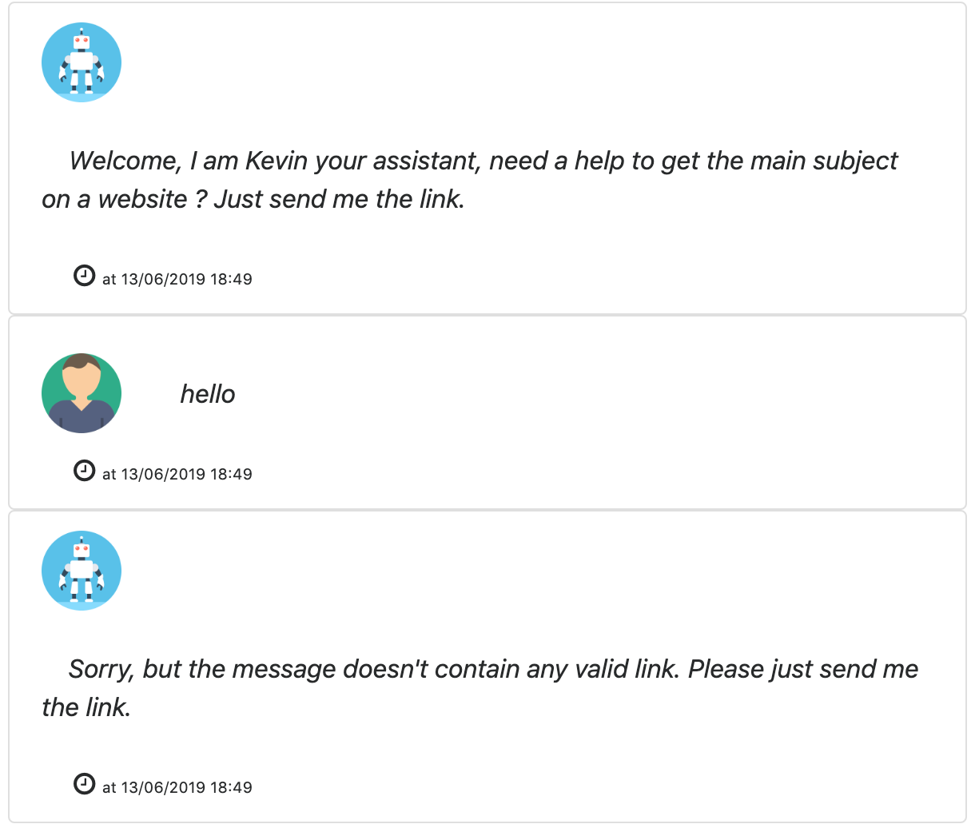
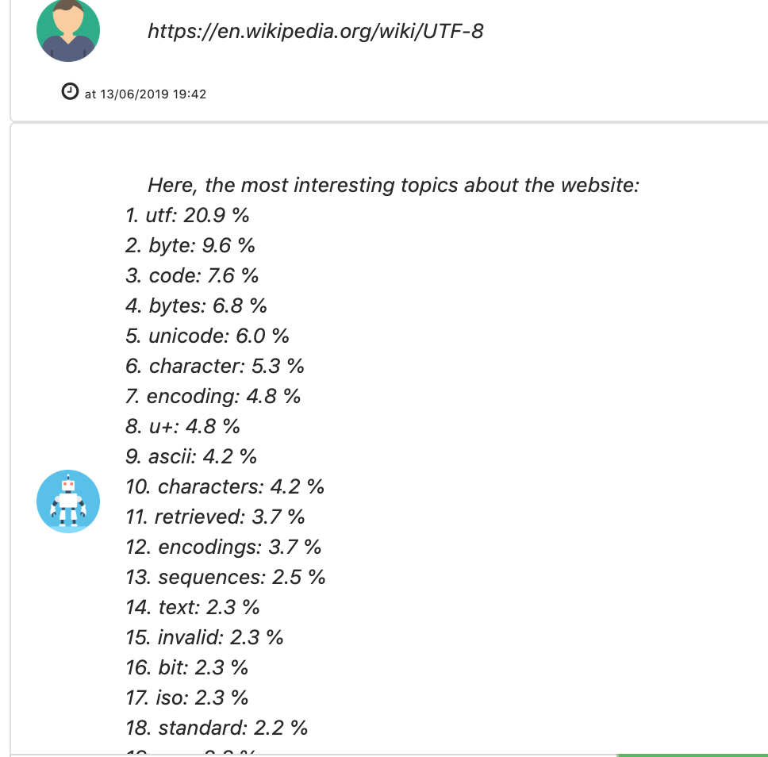
Demonstration
Slide 8
Project Overview

Slide 10
Thanks for listening
Slide 8
Project Overview

